Slide 1
Big Data Analytics Unit 8 Introduction to Pig
Prof.P.R.Gadekar
SKN Sinhgad College of Engineering , Pandharpur

Slide 2
Introducing Pig
What is pig?
Apache Pig is a platform for data analysis.
It is an alternative to MapReduce Programming.
Pig was developed as a research project at Yahoo.

Slide 3
Key Features of Pig
1. It provides an engine for executing data flows (how your data should flow). Pig processes data in parallel on the Hadoop cluster.
2. It provides a language called “Pig Latin” to express data flows.

Slide 4
Key Features of Pig
3. Pig Latin contains operators for many of the traditional data operations such as join, filter, sort, etc.
4. It allows users to develop their own functions (User Defined Functions) for reading, processing, and writing data.

Slide 5
History of Pig
Pig was developed as a research project at Yahoo around 2006 for researchers to have an ad-hoc way of creating and executing MapReduce jobs on very large data sets.

Slide 6
Anatomy of Pig
The main components of Pig are as follows:
1. Data flow language (Pig Latin).
2. Interactive shell where you can type Pig Latin statements (Grunt).
3. Pig interpreter and execution engine.

Slide 7
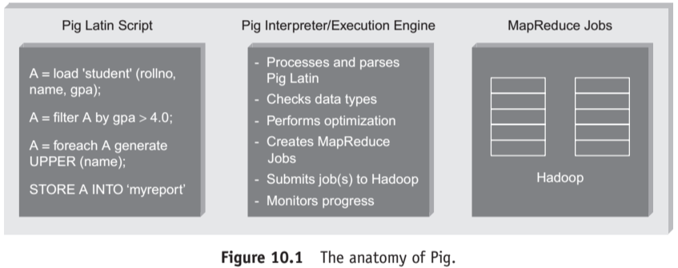

Slide 8
PIG ON HADOOP
Pig runs on Hadoop.
Pig uses both Hadoop Distributed File System and MapReduce Programming.
By default, Pig reads input files from HDFS.
Pig stores the intermediate data (data produced by MapReduce jobs) and the output in HDFS.
Pig can also read input from and place output to other sources.

Slide 9
Pig supports the following:
1. HDFS commands.
2. UNIX shell commands.
3. Relational operators.
4. Positional parameters.
5. Common mathematical functions.
6. Custom functions.
7. Complex data structures.

Slide 10
PIG PHILOSOPHY
1. Pigs Eat Anything:
Pig can process different kinds of data such as structured and unstructured data.
2. Pigs Live Anywhere:
Pig not only processes files in HDFS, it also processes files in other sources such as files in the local file system.

Slide 11
3. Pigs are Domestic Animals:
Pig allows you to develop user-defined functions and the same can be included in the script for complex operations.
4. Pigs Fly:
Pig processes data quickly.

Slide 12
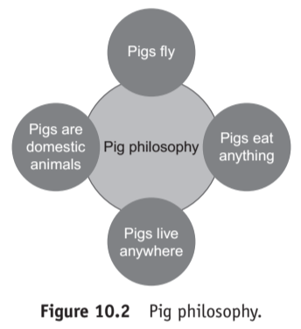

Slide 13
ETL Processing
Pig is widely used for “ETL” (Extract, Transform, and Load).
Pig can extract data from different sources such as ERP, Accounting, Flat Files, etc.
Pig then makes use of various operators to perform transformation on the data and subsequently loads it into the data warehouse. Refer Figure 10.3.

Slide 14
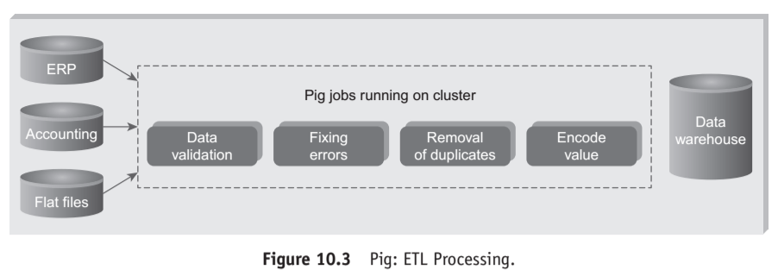

Slide 15
Pig Latin Overview
1 Pig Latin Statements
1. Pig Latin statements are basic constructs to process data using Pig.
2. Pig Latin statement is an operator.
3. An operator in Pig Latin takes a relation as input and yields another relation as output.

Slide 16
4. Pig Latin statements include schemas and expressions to process data.
5. Pig Latin statements should end with a semi-colon.

Slide 17
Pig Latin Statements are generally ordered as follows:
1. LOAD statement that reads data from the file system.
2. Series of statements to perform transformations.
3. DUMP or STORE to display/store result.

Slide 18
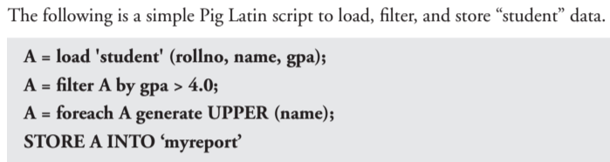
In above example A is relation not a variable

Slide 19
2 Pig Latin:
Keywords Keywords are reserved. It cannot be used to name things.
3 Pig Latin: Identifiers
1. Identifiers are names assigned to fields or other data structures.
2. It should begin with a letter and should be followed only by letters, numbers, and underscores.

Slide 20
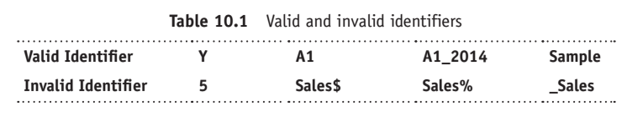

Slide 21
4 Pig Latin: Comments
In Pig Latin two types of comments are supported:
1. Single line comments that begin with “--”.
2. Multiline comments that begin with “/* and end with */”.

Slide 22
5 Pig Latin: Case Sensitivity
1. Keywords are not case sensitive such as LOAD, STORE, GROUP, FOREACH, DUMP, etc.
2. Relations and paths are case-sensitive.
3. Function names are case sensitive such as PigStorage, COUNT.

Slide 23
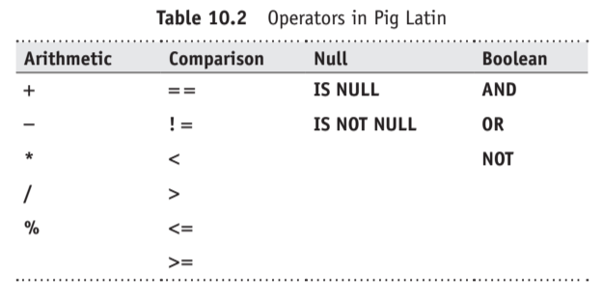
6. Operators in Pig Latin

Slide 24
Word count example using Pig 1
Word Count Example Using Pig Script: lines = LOAD '/user/hadoop/HDFS_File.txt' AS (line:chararray);
words = FOREACH lines GENERATE FLATTEN(TOKENIZE(line)) as word;
grouped = GROUP words BY word;
wordcount = FOREACH grouped GENERATE group, COUNT(words);
DUMP wordcount;

Slide 25
This pig script, first splits each line into words using the TOKENIZE operator.
The tokenize function creates a bag of words.
Using the FLATTEN function, the bag is converted into a tuple.
In the third statement, the words are grouped together so that the count can be computed which is done in fourth statement.

Slide 26
Word count Example using Pig 2
Input file : mary
Mary had a little lamb
its fleece was white as snow
and everywhere that Mary went
the lamb was sure to go.

Slide 27
-- Load input from the file named Mary, and call the single
-- field in the record 'line'.
input = load 'mary' as (line);

Slide 28
-- TOKENIZE splits the line into a field for each word.
-- flatten will take the collection of records returned by
-- TOKENIZE and produce a separate record for each one, calling the single
-- field in the record word.
words = foreach input generate flatten(TOKENIZE(line)) as word;

Slide 29
-- Now group them together by each word.
grpd = group words by word;
-- Count them.
cntd = foreach grpd generate group, COUNT(words);
-- Print out the results.
dump cntd;

Slide 30
OUTPUT
Mary,2
had,1
a,1
little,1
lamb,2
its,1
fleece,1

Slide 31
was,2
white,1
as,1
snow,1
and,1
everywhere,1
that,1
went,1
the,1
sure,1
to,1
go,1

Slide 32
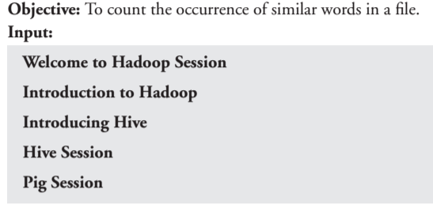
Word count example using Pig 3

Slide 33
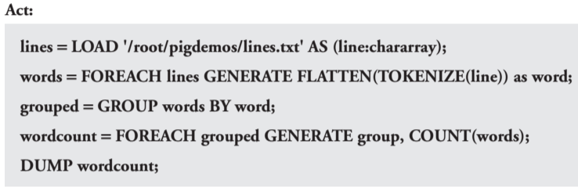

Slide 34
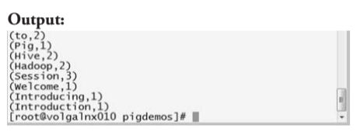

Slide 35
Thank You!

